Slide 1

FLIP ROBO TECHNOLOGIES Internship 32
FAKE NEWS DETECTION
Project
Submtted By : Shahla M
SME : Khushboo Garg

Slide 2
CONTENTS
Introduction
Business Problem Framing
Conceptual Background of Problem
Review of Literature
Importance of Used Cars
Data Analysis & Model Building Flowchart
Exploratory Data Analysis Steps
Visualizations: Univariate and Bivariate
Data Analysis Steps Done
Assumptions
Model Building
Hyper Parameter Tuning and Crating Final Model
Saving the model and prediction results
Conclusion

Slide 3
Introduction
How much of what we read on social media and on supposedly “credible” news sites is trustworthy? It is extremely easy for anyone to post what they desire and although that can be acceptable, there is the notion of taking it a step too far, such as posting false information online in order to cause a panic, using lies to manipulate another person’s decision, or essentially anything else that can have lasting repercussions. There is so much information online that it is becoming impossible to decipher the true from the false. Thus, this leads to the problem of fake news.
Fake news is intentionally written to mislead readers to believe false information, which makes it difficult and nontrivial to detect based on news content; therefore, we need to include auxiliary information, such as user social engagements on social media, to help make a determination.
Exploiting this auxiliary information is challenging in and of itself as users' social engagements with fake news produce data that is big, incomplete, unstructured, and noisy. Because the issue of fake news detection on social media is both challenging and relevant, we conducted this survey to further facilitate research on the problem.
In this Project, we present a comprehensive review of detecting fake news on social media, including fake news characterizations on psychology and social theories, existing algorithms from a data mining perspective, evaluation metrics and representative datasets.

Slide 4

Problem Statement
Fake news has become one of the biggest problems of our age. It has serious impact on our online as well as offline discourse. One can even go as far as saying that, to date, fake news poses a clear and present danger to western democracy and stability of the society.
Fake news's simple meaning is to incorporate information that leads people to the wrong path. Nowadays fake news spreading like water and people share this information without verifying it. This is often done to further or impose certain ideas and is often achieved with political agendas.
We have to detect that the news are published on websites these are fake news or not. For this we analyze our data and then apply model to get better prediction regarding the news.

Slide 5

Problem Statement
Analytical Problem Framing:
Mathematical/ Analytical Modeling of the Problem: We use Statistical techniques and analytics modeling in our projects, such as:
• describe() : use to calculate the statistical values that are mean, standard deviation, quantile deviation, minimum and maximum values.
• corr(): use to calculate the relation between feature variable with the target variable.
From the problem statement we came to know There are two datasets one for fake news and one for true news. We are combined both datasets using pandas built-in function. Machine learning data only works with numerical features so we have to convert text data into numerical columns. So we have to preprocess the text by steaming, lemmatization, remove stopwords, remove specialsymbols and numbers, etc.

Slide 6

What is Fake News ?
Fake news refers to information content that is false, misleading or whose source cannot be verified. This content may be generated to intentionally damage reputations, deceive, or to gain attention. The term rose to popularity during the 2016 US Presidential Elections. It was reported that fake news likely influenced the results of the elections.
Social media platforms are incredibly influential. According to internet live stats the estimated daily number of tweets is about 500 million. These platforms are ubiquitous. They are the go-to environment to share thoughts, feelings, opinions, and intentions. This provides ideal conditions to distribute news with minimal guidelines and restrictions.
In today’s world, it is normal to receive news from online sources like social media. News is often subjective to readers. We often choose to ingest content that appeals to the different emotions we have. So, considering this, the information that gets the most reach may not be real or accurate news. Additionally, real news may be twisted in transmission.

Slide 7
Importance of Fake news Detection:
You deserve the truth. You are smart enough to make up your own mind - as long as you have the real facts in front of you. You have every right to be insulted when you read fake news, because you are in essence being treated like an idiot.
Fake news destroys your credibility. If your arguments are built on bad information, it will be much more difficult for people to believe you in the future.
Fake news can hurt you, and a lot of other people. Purveyors of fake and misleading medical advice like Mercola.com and NaturalNews.com help perpetuate myths like HIV and AIDS aren't related, or that vaccines cause autism. These sites are heavily visited and their lies are dangerous.
Real news can benefit you. If you want to buy stock in a company, you want to read accurate articles about that company so you can invest wisely. If you are planning on voting in an election, you want to read valid and factual information on a candidate so you can vote for the person who best represents your ideas and beliefs. Fake news will not help you make money or make the world a better place, but real news can.

Slide 8
Data Analysis and Model Building Flowchart
Import Libraries
Import Collected Dataset
Data Preprocessing
Identifying Outliers and Skewness
Visualizations
(EDA)
Finding and Treating Null Values
Label Encoder
Checking Correlation and VIF
Model Building
Saving the Model & Predictions
Hyper Parameter Tuning
R2 score, CV & Evaluation Metrics

Slide 9
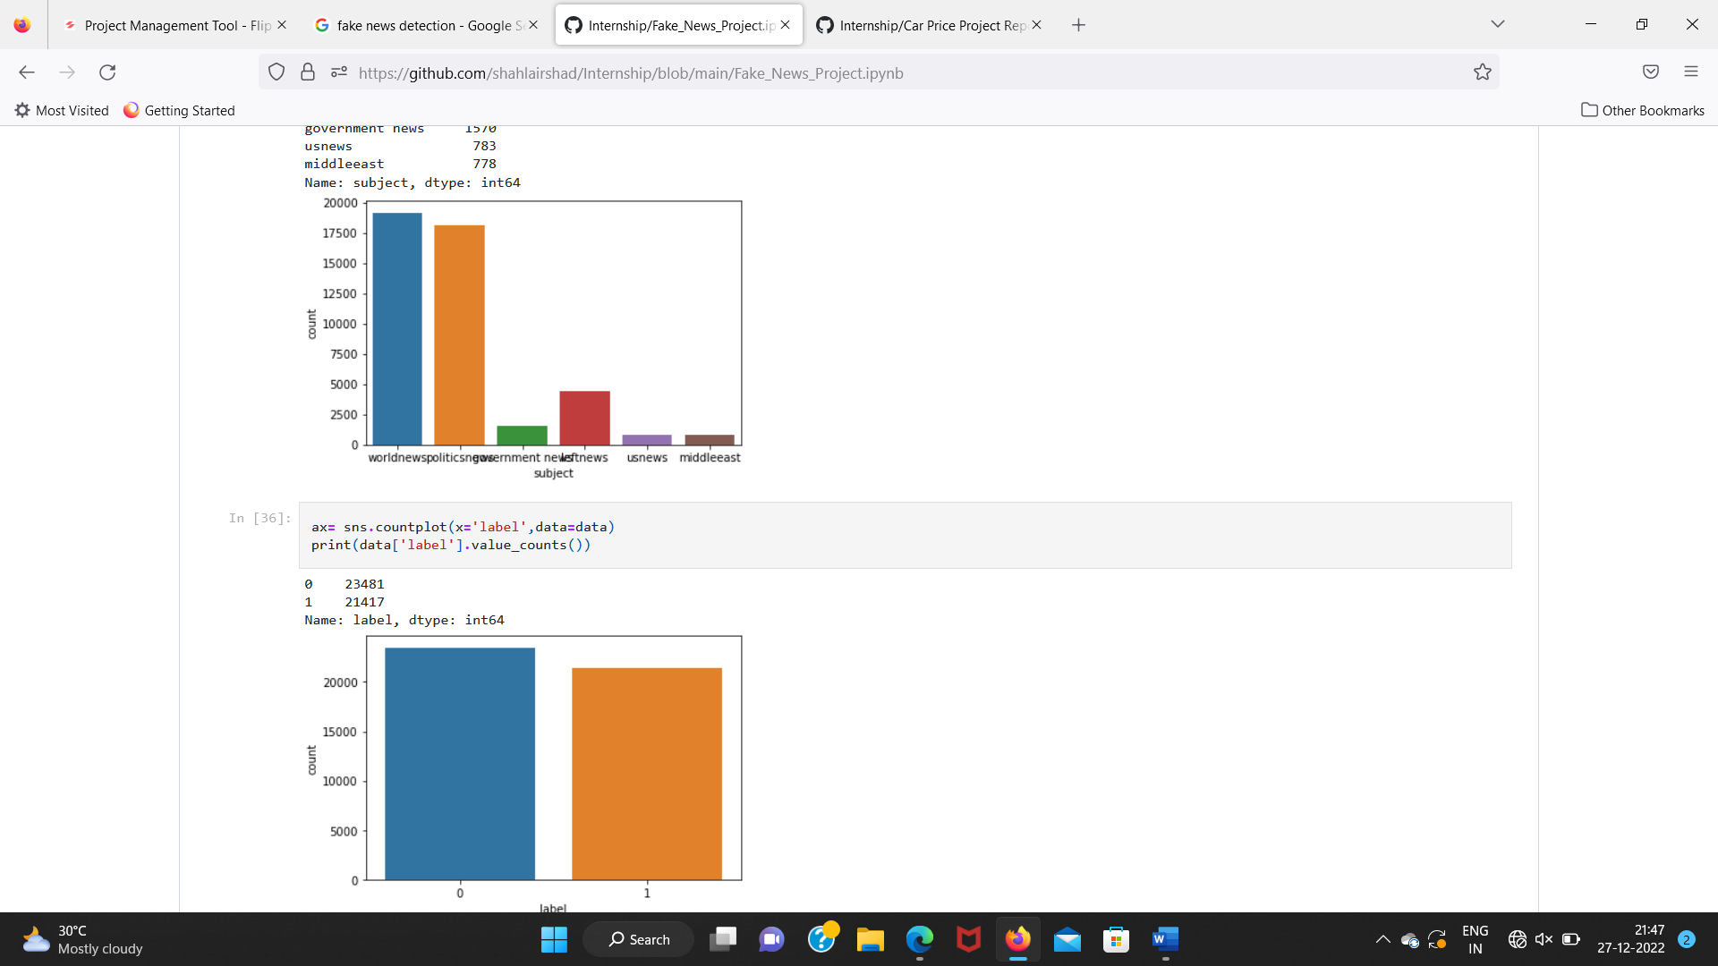
Exploratory Data Analysis (EDA) Steps
In fake data there are 23481 rows 4 columns and in true data there are 21417 rows 4 columns. In data we insert one columns as ‘label’ where zero is for fake news and one for true news.
Both true and fake news data are combined by append method.
All the feature variables are of object type and target variable is of integer type.
Use NLP to remove unnecessary details in the text.
We visualize the categorical data by countplot.
Convert object data into float data type by encoding technique.
Describes the data in statistical terms.
Identify the relationship between dependent and independent variable.

Slide 10
Steps and Assumptions used to complete the project
We have no target variable in the bot dataset, so insert label column and fill zero and one in fake and true data respectively.
We may work with the same text but still remove the unnecessary text from the data by stemming, removing symbols, removing numbers etc.
After removing convert text into numerical type because machine learning works only on numerical columns.

Slide 11
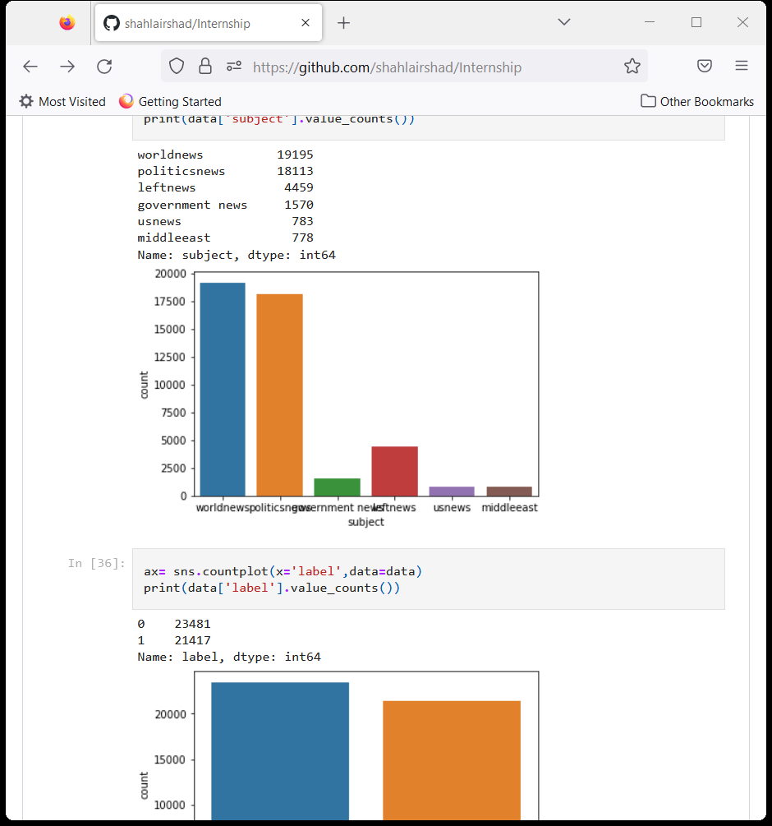
MODEL DASHBOARD
This is a classification based problem and the data is balanced. After that we splitting the train and test data then we fit the model. The AUC scores we get on fitting the model are:
.
The above plot gives the count of fake news for different fields such as world news , politics government us news middle east news

Slide 12
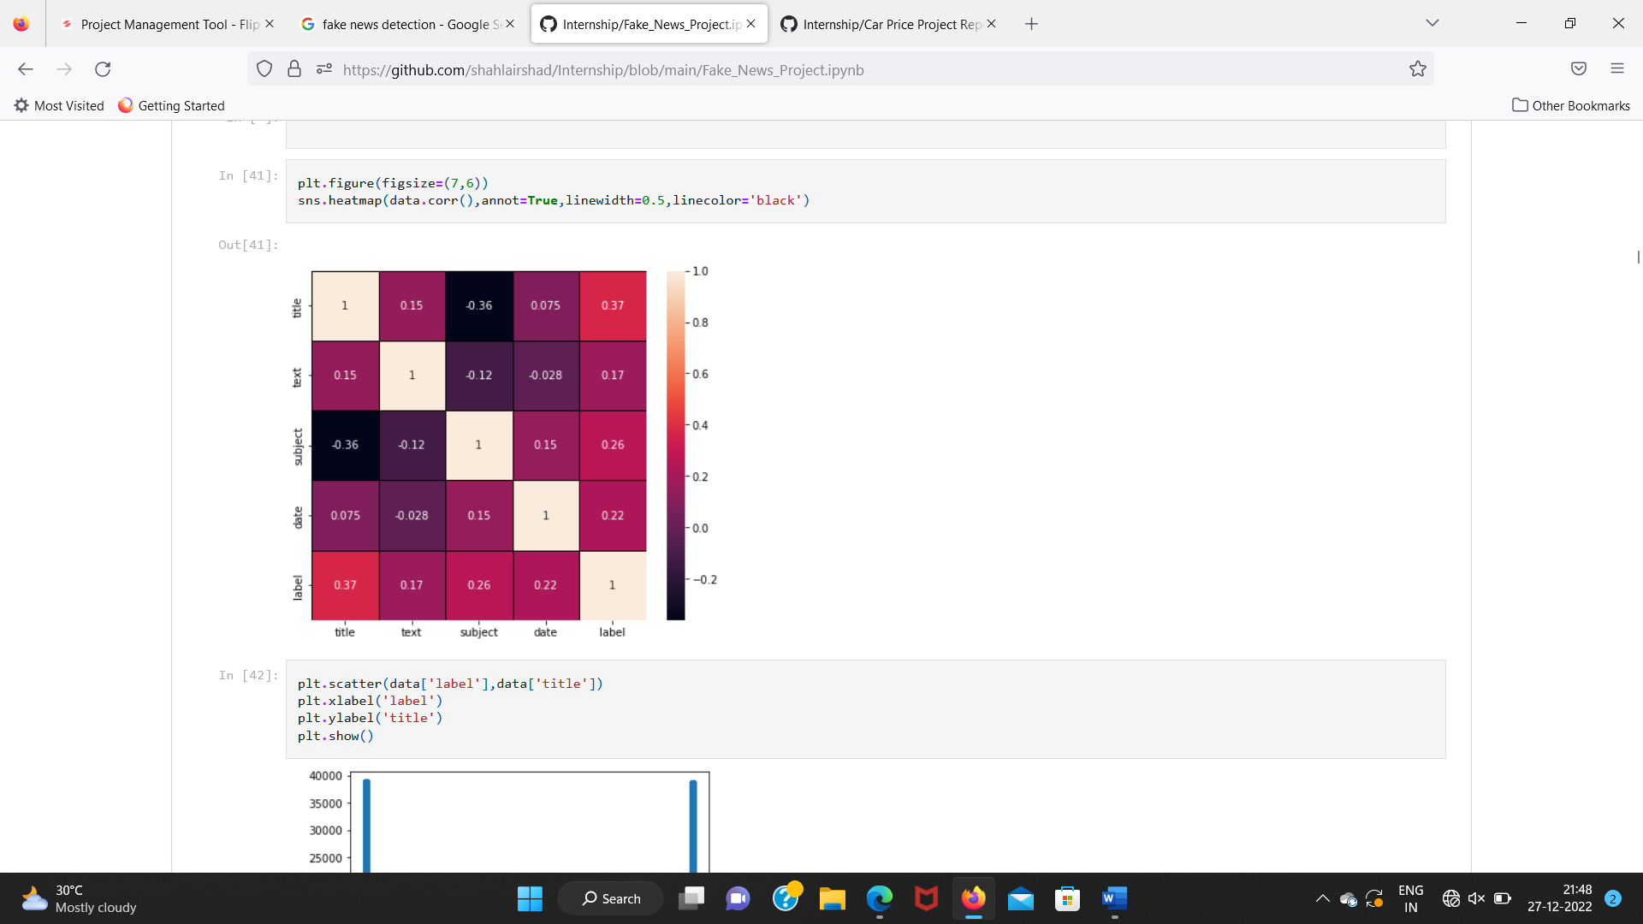
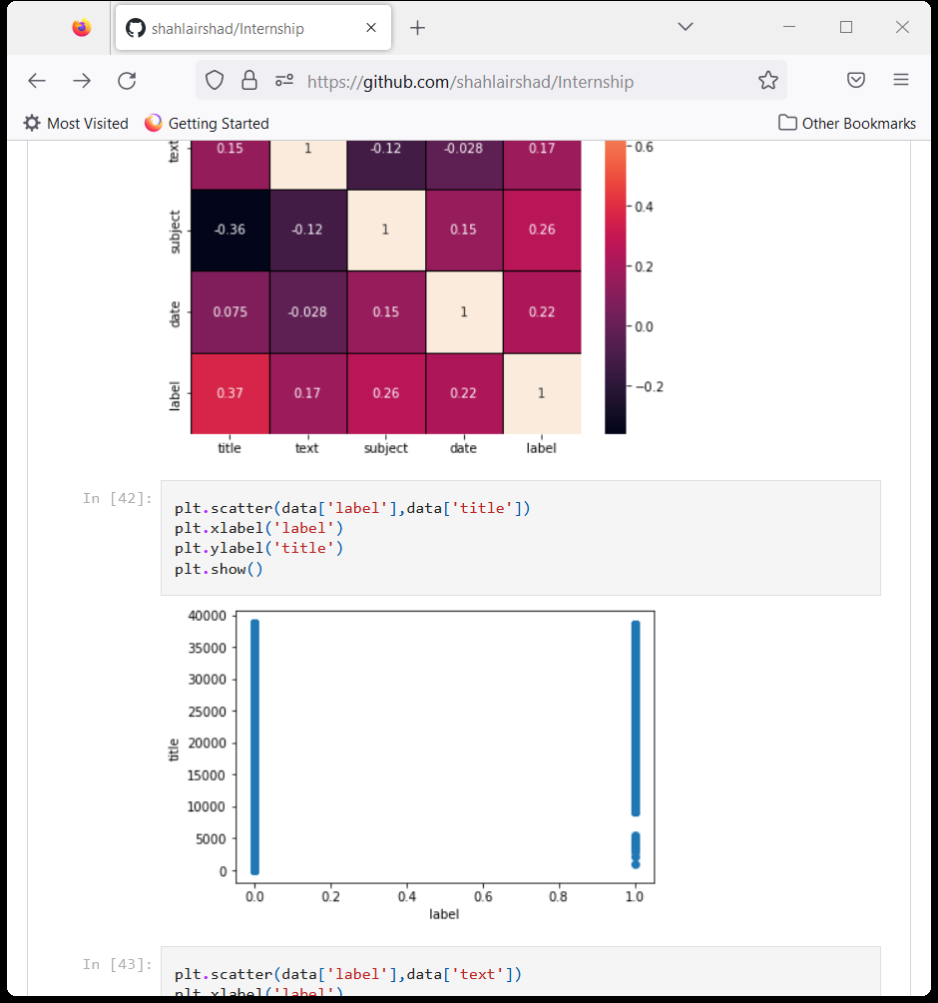
Correlation Between Features and Label
On studying the data we conclude that Decision Tree Classifier model is better for this project.
This model predicts 99% correct replies for the news and only 1% information of news are predicting wrong which is very small difference in the prediction.
So, Decision Tree predicts better responses for an input is given.

Slide 13
Model Building:
This is a classification based problem and the data is balanced. After that we splitting the train and test data then we fit the model. The AUC scores we get on fitting the model are:
Logistic Regression: 56.5%
K Neighbors Classification: 87.2%
Random Forest Classification: 99.44%
Decision Tree Classification: 99.94%
I have got the best random state and maximum R2 score and then created train test split to build the above models.

Slide 14
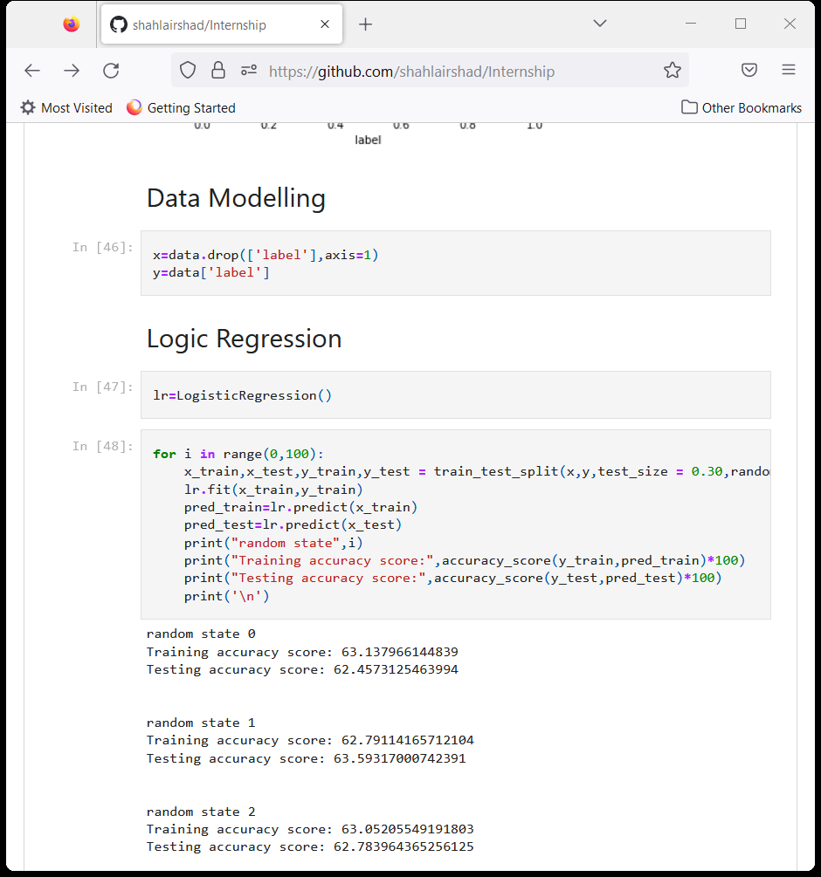
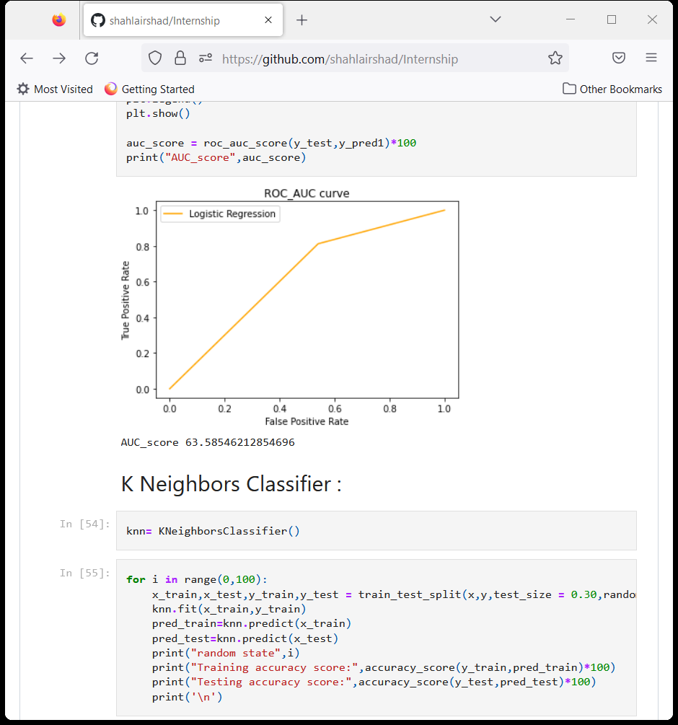
Linear Regression
Created Linear regression model and checked for its evaluation metrics. The model is giving R2 score as 90.5%.
From the graph we can observe how our model is mapping.

Slide 15
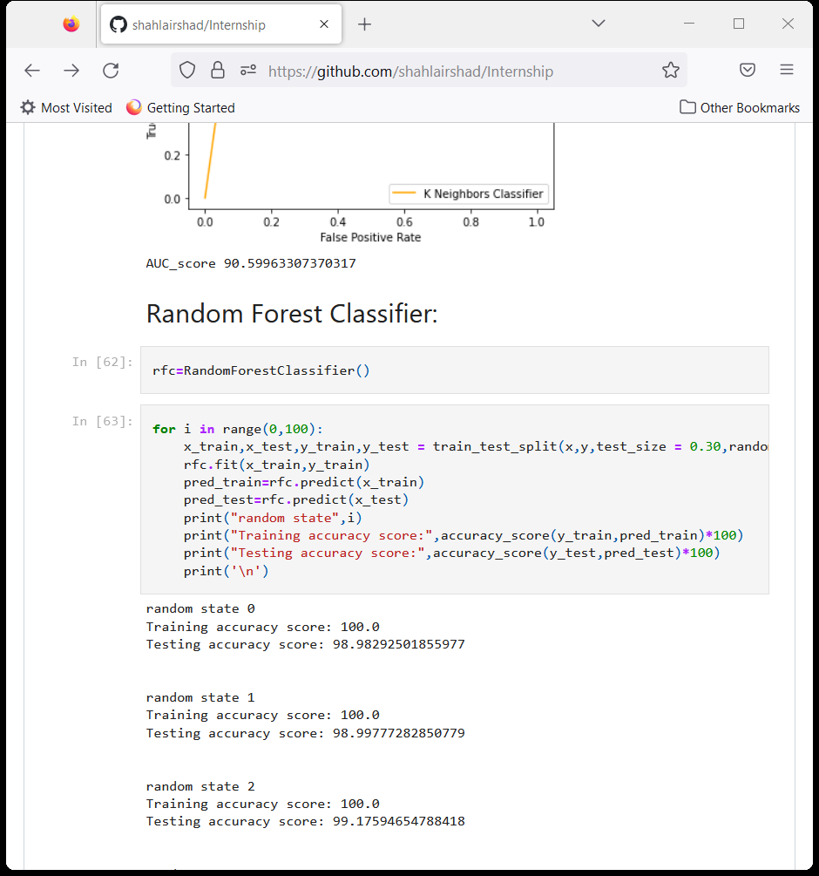
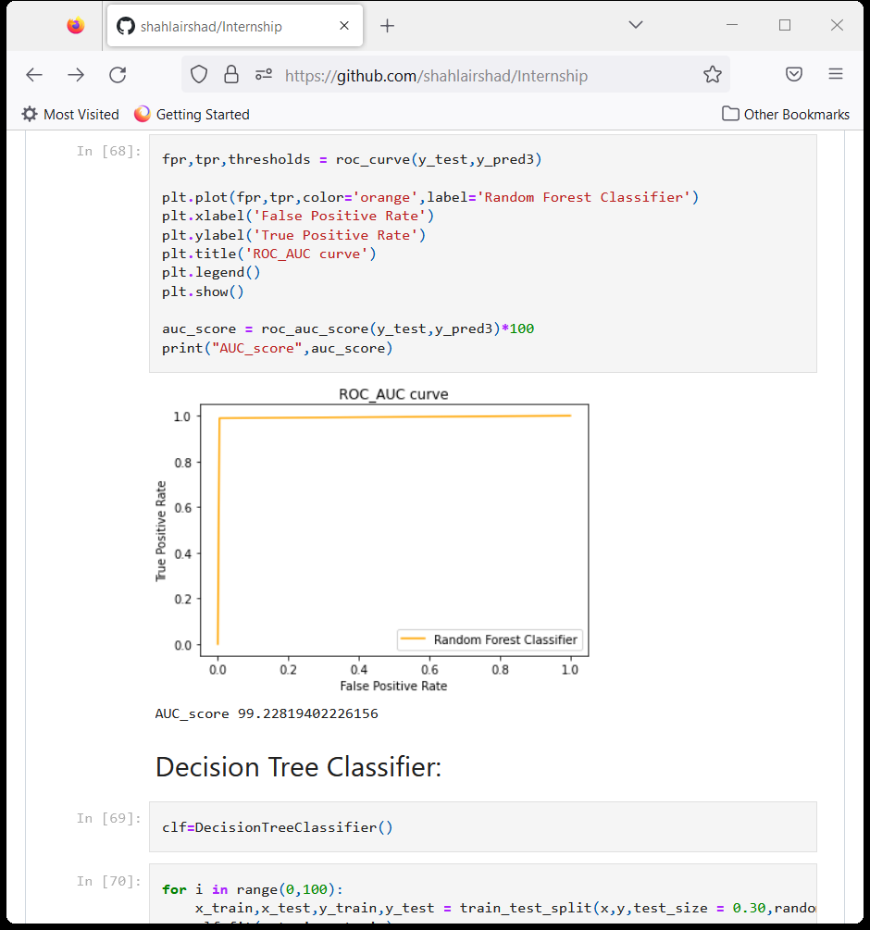
ii. Random Forest Regressor:
Created Random Forest Regressor model and checked for it's evaluation metrics. The model is giving R2 score as 99.22%.
From the graph we can observe how our model is mapping.

Slide 16
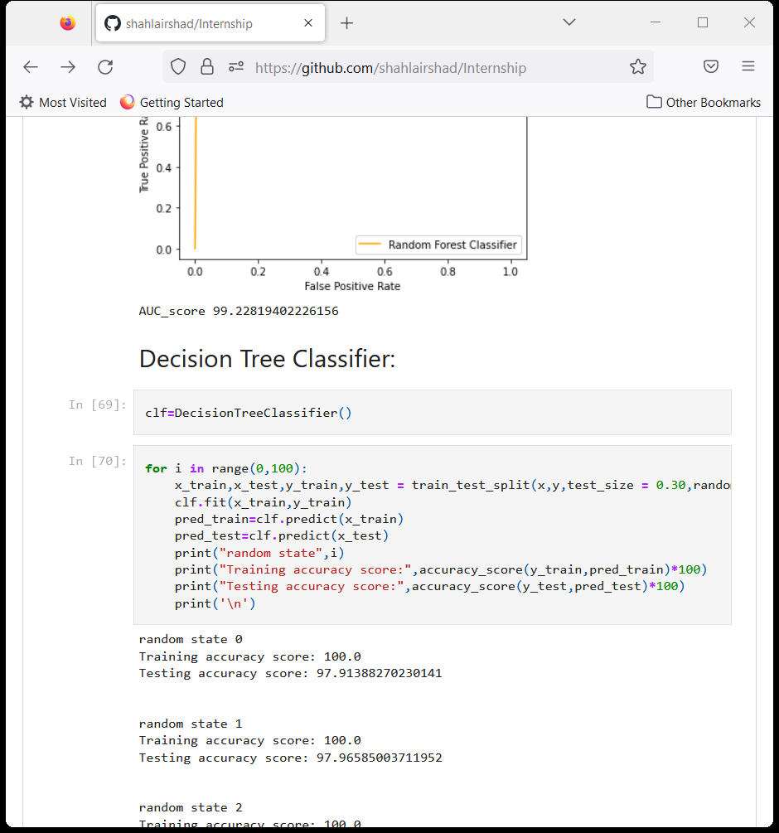
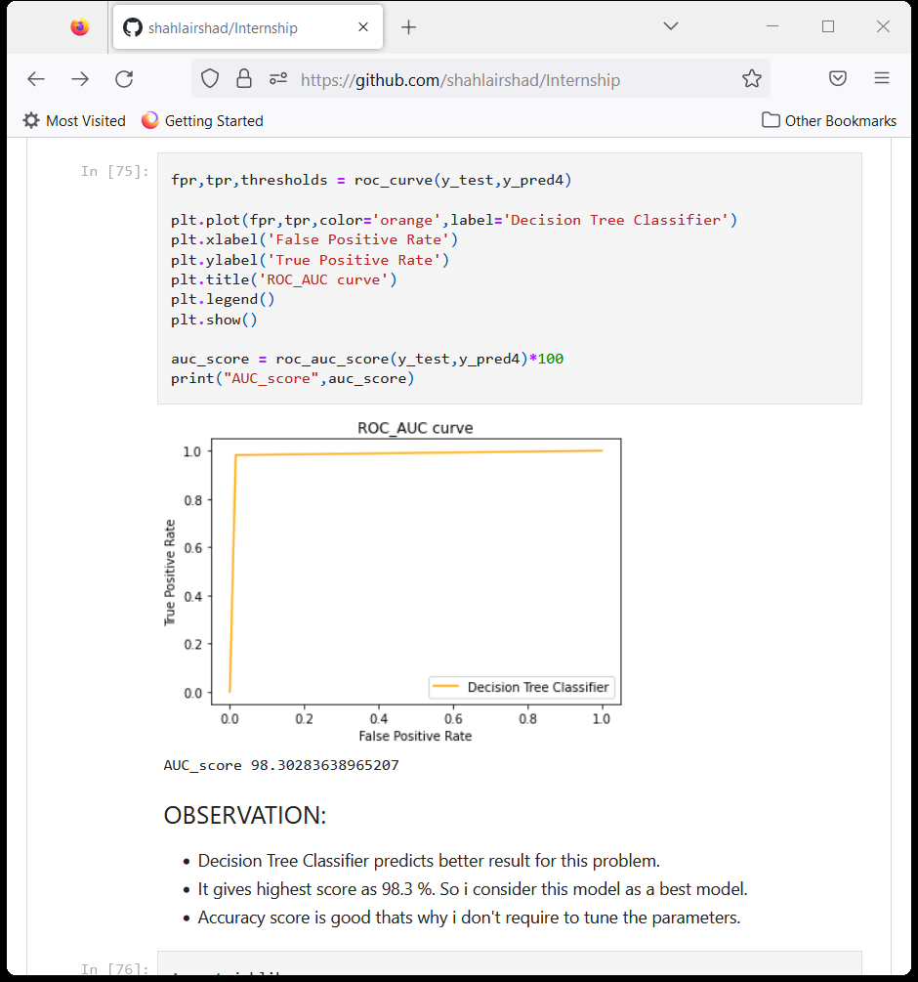
iii. Decision Tree Regressor:
We have created Decision Trees Regressor model and checked for its evaluation metrics. And the model is giving R2 score as 98.3%.
From the graph we can observe how our model is mapping..

Slide 17
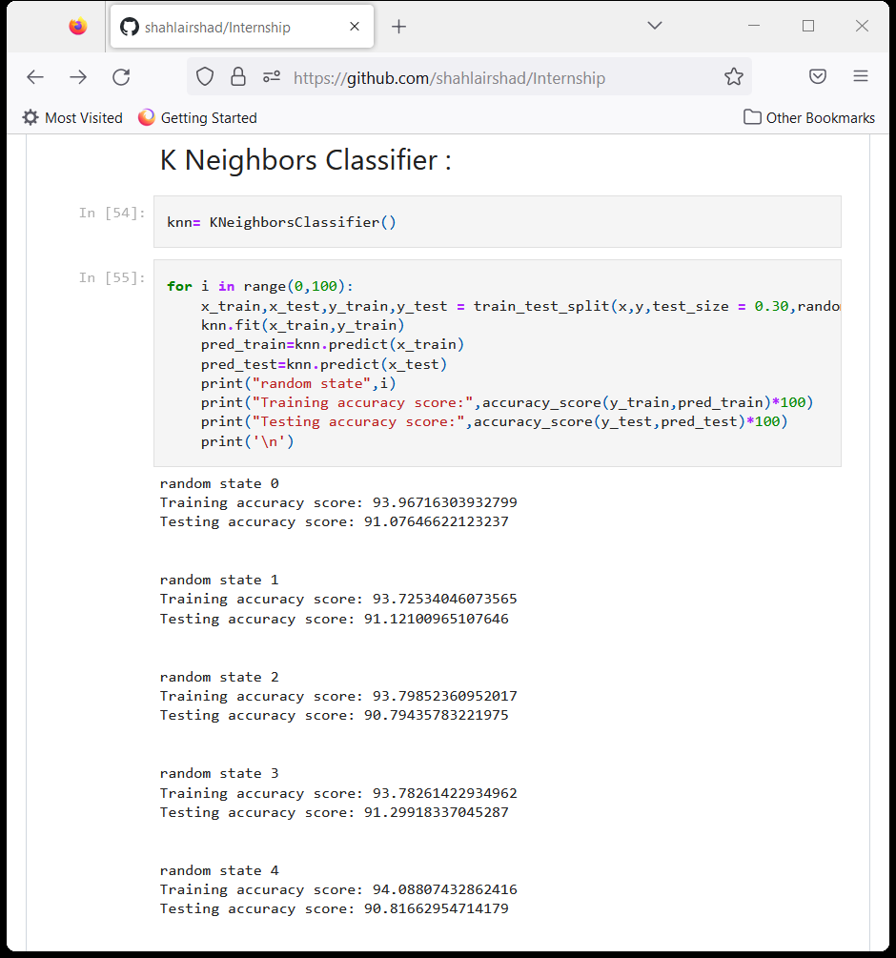
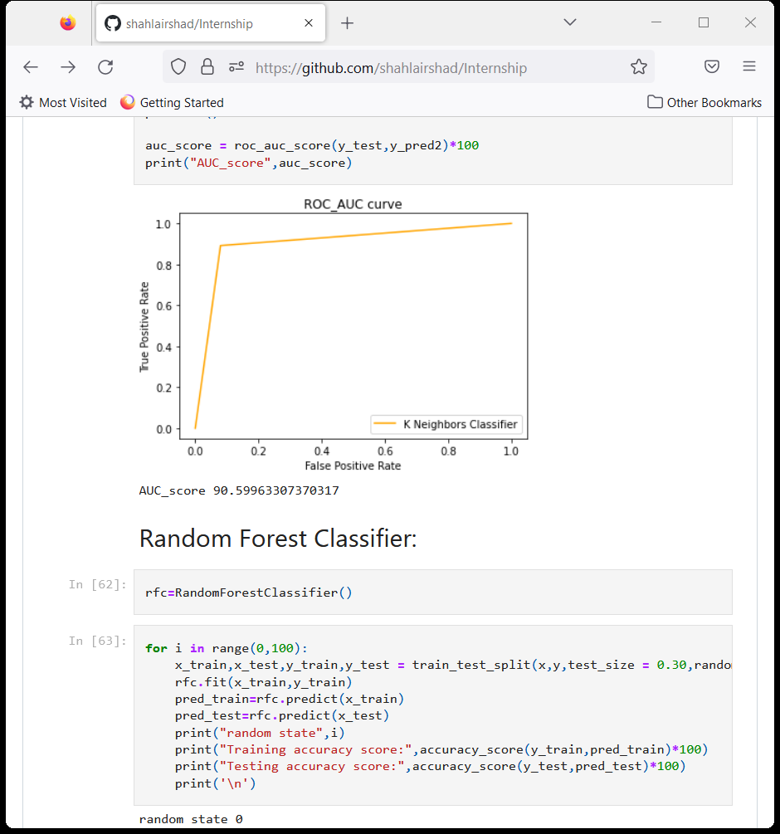
vii. KNeighbors Regressor
Created KNN Regressor model and checked for its evaluation metrics. The model is giving R2 score as 90.59%.
From the graph we can observe how our model is mapping. In the graph we can observe the straight line which is our actual dataset and the dots are the predictions that our model has given.

Slide 18
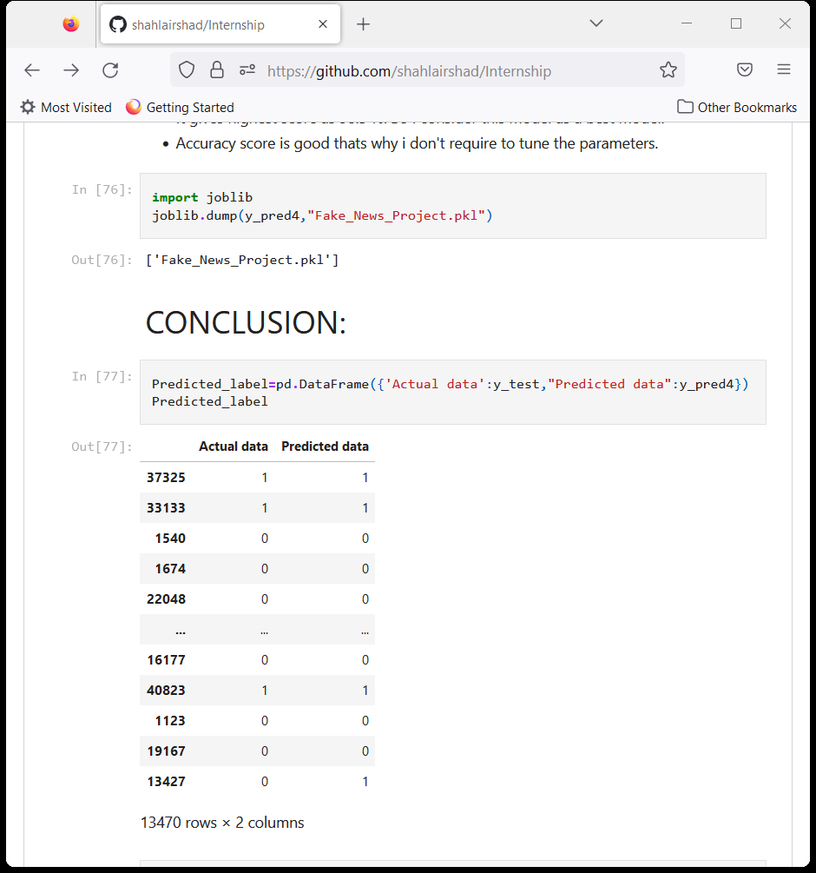
Saving The Final Model And Predictions From Saved Model
The Decision Tree Classifier model gives better accuracy score. Precision score, recall and f1-score is also good in compare to the other. The total of True Negative and False Negative in the confusion matrix is also less in the same model. So, this model is best for the fake news and classification project.

Slide 19
Conclusion:
On studying the data we conclude that Decision Tree Classifier model is better for this project.
This model predicts 99% correct replies for the news and only 1% information of news are predicting wrong which is very small difference in the prediction.
So, Decision Tree predicts better responses for an input is given.

Slide 20


